Slide 1
INTRODUCTION
An operating system (OS) is a collection of software that manages computer hardware resources and provides common services for computer programs. The operating system is a vital component of the system software in a computer system.
User
Operating System
Hardware
Why to Learn Operating System?
An Operating System (OS) is an interface between a computer user and computer hardware. An operating system is a software which performs all the basic tasks like file management, memory management, process management, handling input and output, and controlling peripheral devices such as disk drives and printers.
Some popular Operating Systems include Linux Operating System, Windows Operating System, VMS, OS/400, AIX, z/OS, etc.

Slide 2
Following are some of important functions of an operating System.
      Memory Management
      Processor Management
      Device Management
      File Management
      Security
      Control over system performance
      Job accounting
      Error detecting aids
      Coordination between other software and users

Slide 3
Memory Management
Memory management refers to management of Primary Memory or Main Memory. Main memory is a large array of words or bytes where each word or byte has its own address.
Main memory provides a fast storage that can be accessed directly by the CPU. For a program to be executed, it must in the main memory. An Operating System does the following activities for memory management −
Keeps tracks of primary memory, i.e., what part of it are in use by whom, what part are not in use.
In multiprogramming, the OS decides which process will get memory when and how much.
Allocates the memory when a process requests it to do so.
De-allocates the memory when a process no longer needs it or has been terminated.
Processor Management
In multiprogramming environment, the OS decides which process gets the processor when and for how much time. This function is called process scheduling. An Operating System does the following activities for processor management −
Keeps tracks of processor and status of process. The program responsible for this task is known as traffic controller.
Allocates the processor (CPU) to a process.
De-allocates processor when a process is no longer required.

Slide 4
Device Management
An Operating System manages device communication via their respective drivers. It does the following activities for device management −
Keeps tracks of all devices. Program responsible for this task is known as the I/O controller.
Decides which process gets the device when and for how much time.
Allocates the device in the efficient way.
De-allocates devices.
File Management
A file system is normally organized into directories for easy navigation and usage. These directories may contain files and other directions.
An Operating System does the following activities for file management −
Keeps track of information, location, uses, status etc. The collective facilities are often known as file system.
Decides who gets the resources.
Allocates the resources.
De-allocates the resources.

Slide 5
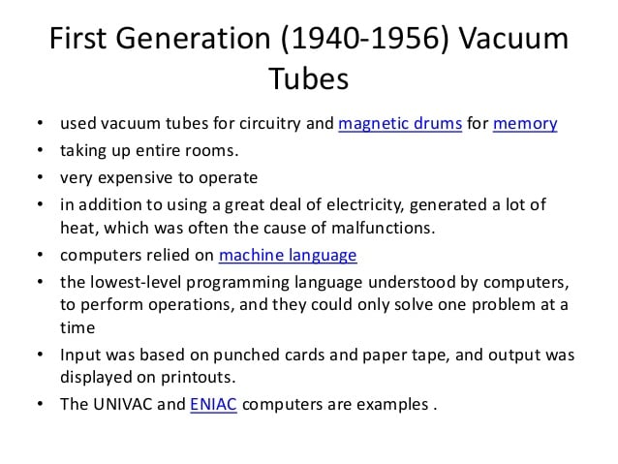
Generation of Operating Systems

Slide 6
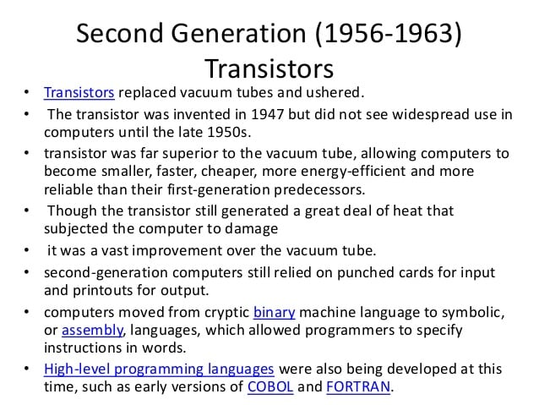
Generation of Operating Systems Contd..

Slide 7
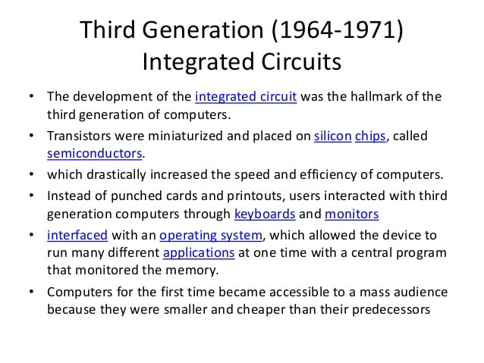
Generation of Operating Systems Contd..

Slide 8
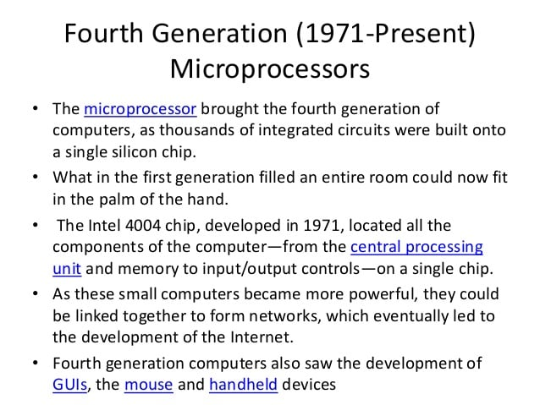
Generation of Operating Systems Contd..

Slide 9
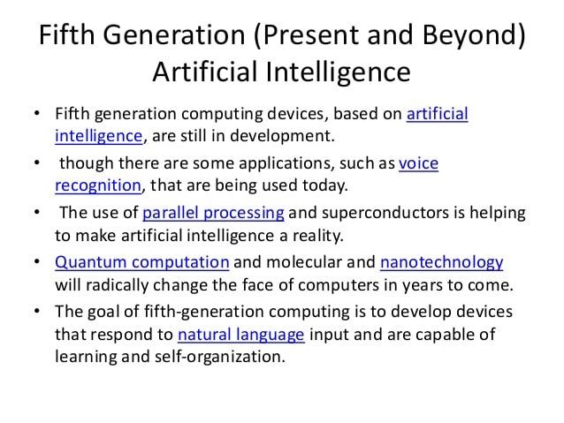
Generation of Operating Systems Contd..

Slide 10
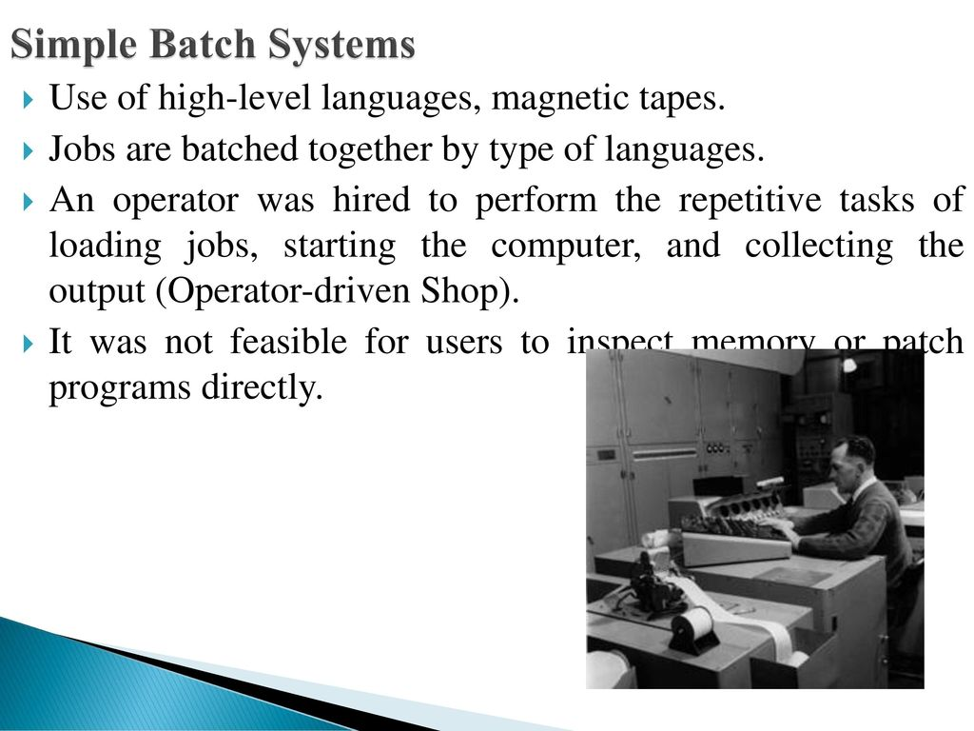

Slide 11
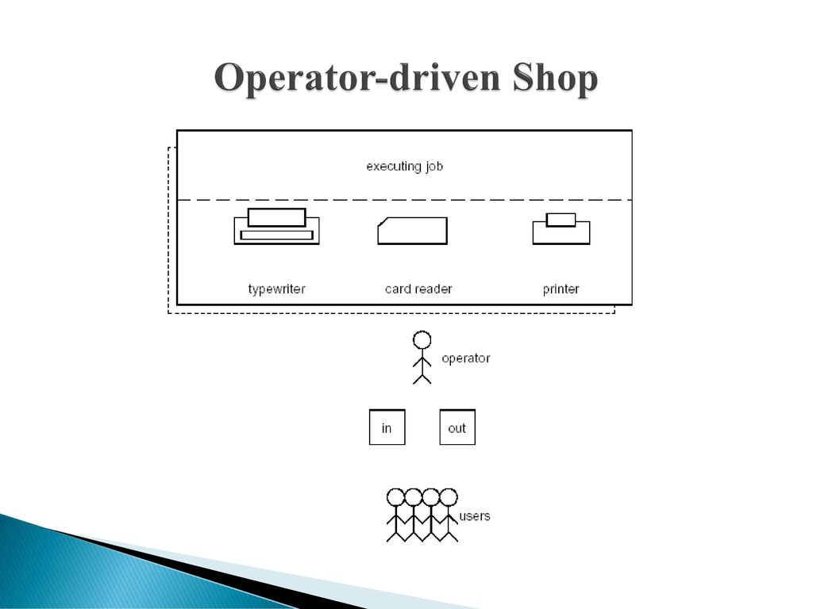

Slide 12
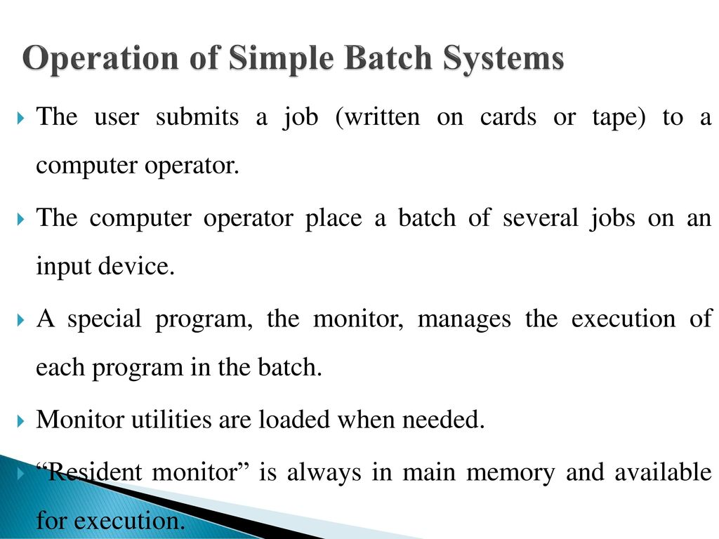

Slide 13
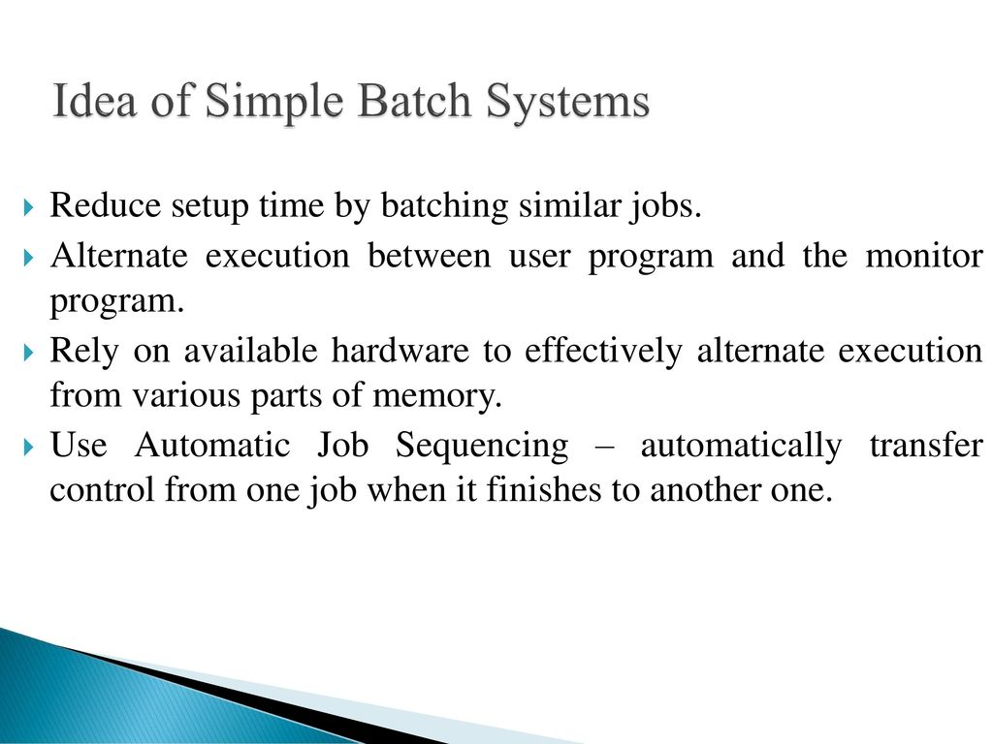

Slide 14
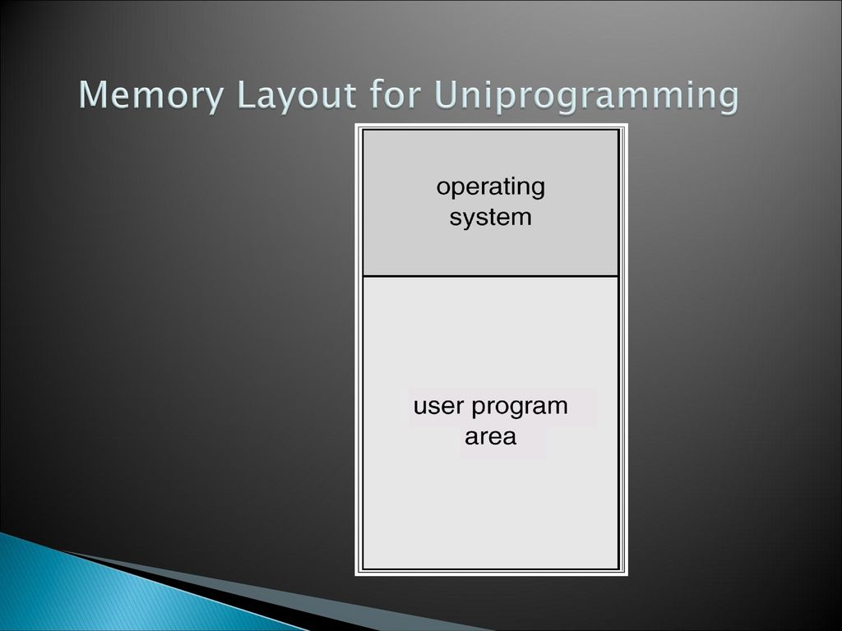

Slide 15
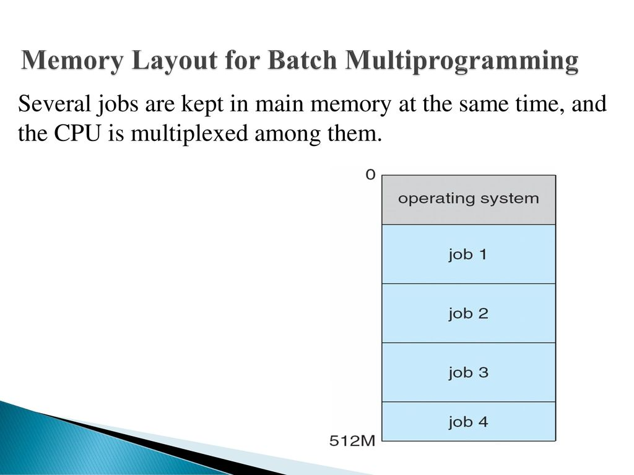

Slide 16
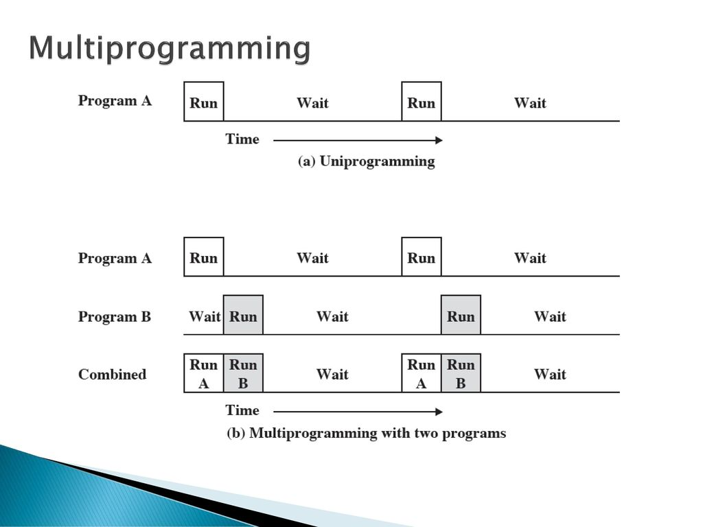

Slide 17
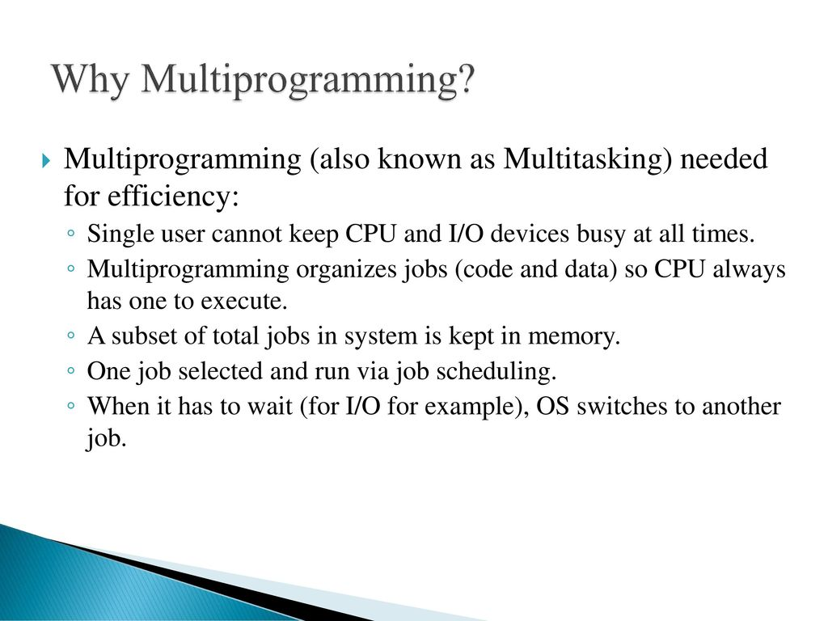

Slide 18
Operating systems are there from the very first computer generation and they keep evolving with time.
Batch operating system
The users of a batch operating system do not interact with the computer directly. Each user prepares his job on an off-line device like punch cards and submits it to the computer operator. To speed up processing, jobs with similar needs are batched together and run as a group. The programmers leave their programs with the operator and the operator then sorts the programs with similar requirements into batches.
The problems with Batch Systems are as follows −
Lack of interaction between the user and the job.
CPU is often idle, because the speed of the mechanical I/O devices is slower than the CPU.
Difficult to provide the desired priority.

Slide 19
Time-sharing operating systems
Time-sharing is a technique which enables many people, located at various terminals, to use a particular computer system at the same time. Time-sharing or multitasking is a logical extension of multiprogramming. Processor's time which is shared among multiple users simultaneously is termed as time-sharing.
The main difference between Multiprogrammed Batch Systems and Time-Sharing Systems is that in case of Multiprogrammed batch systems, the objective is to maximize processor use, whereas in Time-Sharing Systems, the objective is to minimize response time.
Multiple jobs are executed by the CPU by switching between them, but the switches occur so frequently. Thus, the user can receive an immediate response. For example, in a transaction processing, the processor executes each user program in a short burst or quantum of computation. That is, if n users are present, then each user can get a time quantum. When the user submits the command, the response time is in few seconds at most.
The operating system uses CPU scheduling and multiprogramming to provide each user with a small portion of a time. Computer systems that were designed primarily as batch systems have been modified to time-sharing systems.

Slide 20
Advantages of Timesharing operating systems are as follows −
    Provides the advantage of quick response.
    Avoids duplication of software.
    Reduces CPU idle time.
Disadvantages of Time-sharing operating systems are as follows −
    Problem of reliability.
    Question of security and integrity of user programs and data.
    Problem of data communication.

Slide 21
Distributed operating System
Distributed systems use multiple central processors to serve multiple real-time applications and multiple users. Data processing jobs are distributed among the processors accordingly.
The processors communicate with one another through various communication lines (such as high-speed buses or telephone lines). These are referred as loosely coupled systems or distributed systems. Processors in a distributed system may vary in size and function. These processors are referred as sites, nodes, computers, and so on.
The advantages of distributed systems are as follows −
With resource sharing facility, a user at one site may be able to use the resources available at another.
Speedup the exchange of data with one another via electronic mail.
If one site fails in a distributed system, the remaining sites can potentially continue operating.
Better service to the customers.
Reduction of the load on the host computer.
Reduction of delays in data processing.

Slide 22
Real Time operating System
A real-time system is defined as a data processing system in which the time interval required to process and respond to inputs is so small that it controls the environment. The time taken by the system to respond to an input and display of required updated information is termed as the response time. So in this method, the response time is very less as compared to online processing.
Real-time systems are used when there are rigid time requirements on the operation of a processor or the flow of data and real-time systems can be used as a control device in a dedicated application. A real-time operating system must have well-defined, fixed time constraints, otherwise the system will fail. For example, Scientific experiments, medical imaging systems, industrial control systems, weapon systems, robots, air traffic control systems, etc.
There are two types of real-time operating systems.
Hard real-time systems
Hard real-time systems guarantee that critical tasks complete on time. In hard real-time systems, secondary storage is limited or missing and the data is stored in ROM. In these systems, virtual memory is almost never found.
Soft real-time systems
Soft real-time systems are less restrictive. A critical real-time task gets priority over other tasks and retains the priority until it completes. Soft real-time systems have limited utility than hard real-time systems. For example, multimedia, virtual reality, Advanced Scientific Projects like undersea exploration and planetary rovers, etc.

Slide 23
Operating System Services
Operating systems provide an environment for execution of programs.
It provides certain services to programs and to users of those programs.
Following are few common services provided by Operating System.
User Interface
Program Development
Program Execution
I/O Operation
File System Manipulation
Communication
Error Detection
Resource Allocation
Accounting
Protection and Security
Operating System Services

Slide 24
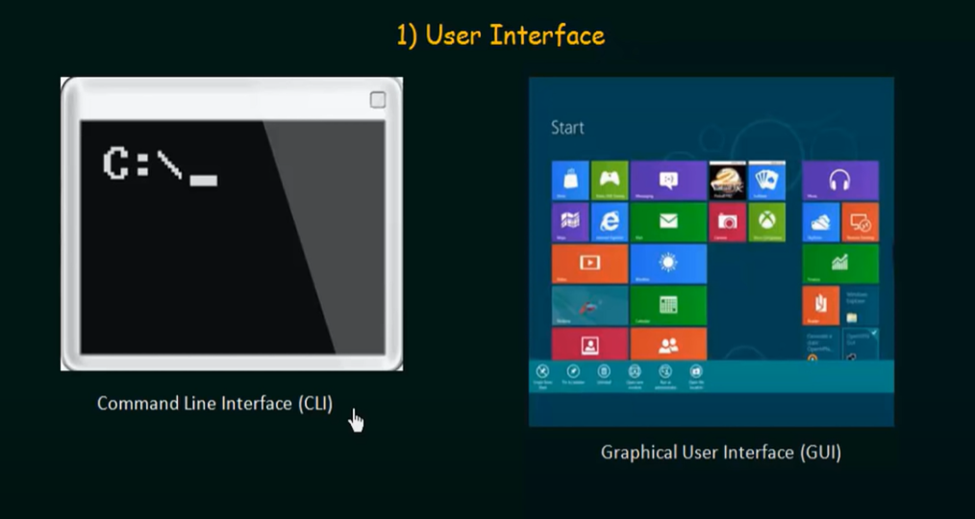
Operating System Services
One set of operating-system services provides functions that are helpful to the user:
  User interface - Almost all operating systems have a user interface (UI).
    Varies between Command-Line (CLI), Graphics User Interface (GUI), Batch
  Program Development – The Operating System provides variety of facilities and services such as editors and debuggers to assist the programmer in creating a program.

Slide 25
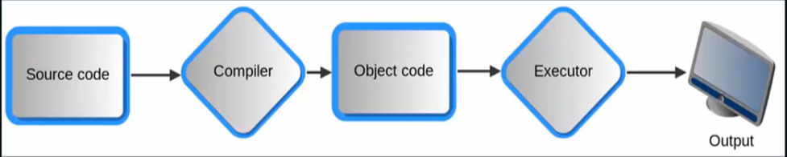
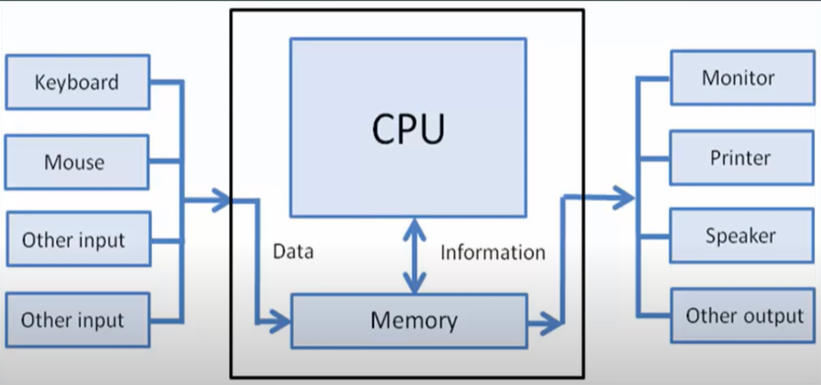
Operating System Services (Cont.)
  Program execution - The system must be able to load a program into memory and to run that program, end execution, either normally or abnormally (indicating error)
  I/O operations - A running program may require I/O, which may involve a file or an I/O device

Slide 26
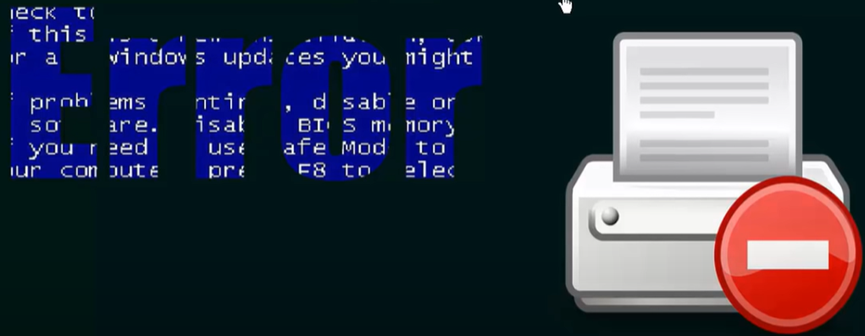
Operating System Services (Cont.)
  File-system manipulation - The file system is of particular interest. Programs need to read and write files and directories, create and delete them, search them, list file Information, permission management.
  Communications – Processes may exchange information, on the same computer or between computers over a network
    Communications may be via shared memory or through message passing (packets moved by the OS)
  Error detection – OS needs to be constantly aware of possible errors
    May occur in the CPU and memory hardware, in I/O devices, in user program
    For each type of error, OS should take the appropriate action to ensure correct and consistent computing
    Debugging facilities can greatly enhance the user’s and programmer’s abilities to efficiently use the system

Slide 27
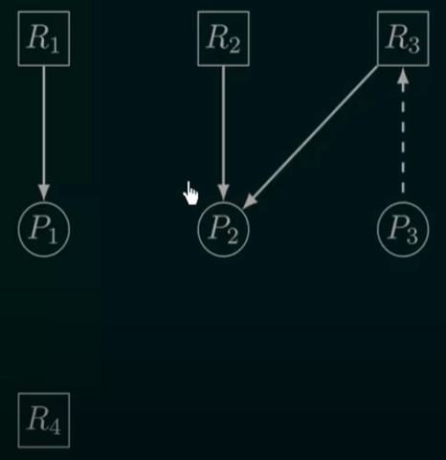
Operating System Services (Cont.)
  Resource allocation - When multiple users or multiple jobs running concurrently, resources must be allocated to each of them
    Many types of resources - CPU cycles, main memory, file storage, I/O devices.
  Accounting - To keep track of which users use how much and what kinds of computer resources (to maintain statistics).
  Protection and security - The owners of information stored in a multiuser or networked computer system may want to control use of that information, concurrent processes should not interfere with each other
    Protection involves ensuring that all access to system resources is controlled
    Security of the system from outsiders requires user authentication, extends to defending external I/O devices from invalid access attempts

Slide 28

A View of Operating System Services

Slide 29
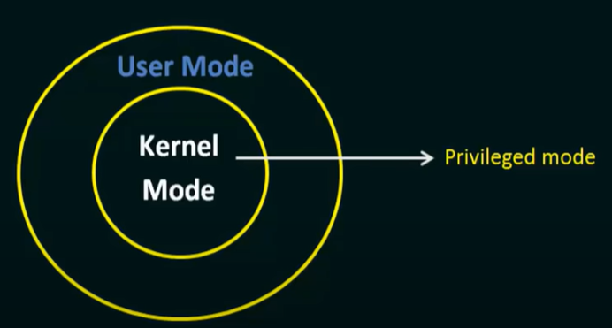
System Calls
Provides interface to the services provided by the OS
System Call is the programmatic way in which the computer program requests a service from the kernel of the operating system.
Typically written in a high-level language (C or C++)
Mostly accessed by programs via a high-level Application Programming Interface (API) rather than direct system call use
Three most common APIs are Win32 API for Windows, POSIX API for POSIX-based systems (including virtually all versions of UNIX, Linux, and Mac OS X), and Java API for the Java virtual machine (JVM)

Slide 30

Example of System Calls
System call sequence to copy the contents of one file to another file

Slide 31

API – System Call – OS Relationship

Slide 32
Types of System Calls
Process Control
File Management
Device Management
Information Maintainance
Communication
Protection

Slide 33
Types of System Calls (Contd..)
Process control
  create process, terminate process
  end, abort
  load, execute
  get process attributes, set process attributes
  wait for time
  wait event, signal event
  allocate and free memory

Slide 34
Types of System Calls (Contd..)
File management
  create file, delete file
  open, close file
  read, write, reposition
  get and set file attributes
Device management
  request device, release device
  read, write, reposition
  get device attributes, set device attributes
  logically attach or detach devices

Slide 35
Types of System Calls (Cont.)
Information maintenance
  get time or date, set time or date
  get system data, set system data
  get and set process, file, or device attributes
Communication
  create, delete communication connection
  send, receive messages
  transfer status information
  attach and detach remote devices

Slide 36
Types of System Calls (Contd.)
Protection
  Control access to resources
  Get and set permissions
  Allow and deny user access

Slide 37

Examples of Windows and Unix System Calls

Slide 38

Standard C Library Example
C program invoking printf() library call, which calls write() system call

Slide 39

Simple Structure -- MS-DOS
Structures of Operating Systems
MS-DOS – written to provide the most functionality in the least space
  Not divided into modules
  Although MS-DOS has some structure, its interfaces and levels of functionality are not well separated

Slide 40

Layered Approach
The operating system is divided into a number of layers (levels), each built on top of lower layers. The bottom layer (layer 0), is the hardware; the highest (layer N) is the user interface.
With modularity, layers are selected such that each uses functions (operations) and services of only lower-level layers

Slide 41
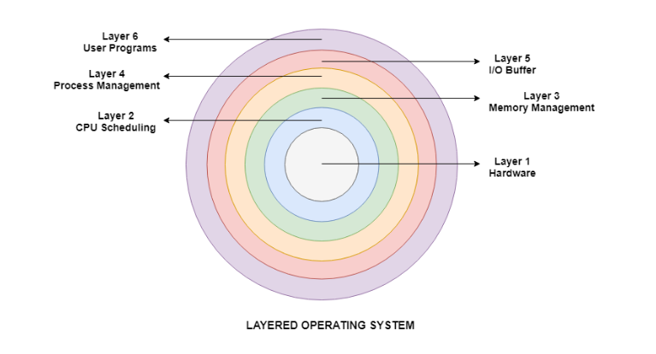
Layered Approach
Details about the six layers are:
Hardware
This layer interacts with the system hardware and coordinates with all the peripheral devices used such as printer, mouse, keyboard, scanner etc. The hardware layer is the lowest layer in the layered operating system architecture.
CPU Scheduling
This layer deals with scheduling the processes for the CPU. There are many scheduling queues that are used to handle processes. When the processes enter the system, they are put into the job queue. The processes that are ready to execute in the main memory are kept in the ready queue.

Slide 42
Layered Approach
Memory Management
Memory management deals with memory and the moving of processes from disk to primary memory for execution and back again. This is handled by the third layer of the operating system.
Process Management
This layer is responsible for managing the processes i.e assigning the processor to a process at a time. This is known as process scheduling. The different algorithms used for process scheduling are FCFS (first come first served), SJF (shortest job first), priority scheduling, round-robin scheduling etc.
I/O Buffer
I/O devices are very important in the computer systems. They provide users with the means of interacting with the system. This layer handles the buffers for the I/O devices and makes sure that they work correctly.
User Programs
This is the highest layer in the layered operating system. This layer deals with the many user programs and applications that run in an operating system such as word processors, games, browsers etc.

Slide 43
Monolothic Structure
A monolithic kernel is an operating system architecture where the entire operating system is working in kernel space. The monolithic model differs from other operating system architectures, such as the microkernel architecture, in that it alone defines a high-level virtual interface over computer hardware.
A monolithic design of the operating system architecture makes no special accommodation for the special nature of the operating system. Although the design follows the separation of concerns, no attempt is made to restrict the privileges granted to the individual parts of the operating system. The entire operating system executes with maximum privileges. The communication overhead inside the monolithic operating system is the same as that of any other software, considered relatively low.

Slide 44
Monolothic Structure
Advantages of Monolithic Architecture:
Monolithic architecture has the following advantages, such as:
  Simple and easy to implement structure.
  Faster execution due to direct access to all the services
Disadvantages of Monolithic Architecture:
Here are some disadvantages of monolithic architecture:
  The addition of new features or removal of obsolete features is very difficult.
  Security issues are always there because there is no isolation among various servers present in the kernel.

Slide 45
Microkernel System Structure
Moves as much from the kernel into user space
Mach example of microkernel
  Mac OS X kernel (Darwin) partly based on Mach
Communication takes place between user modules using message passing
Benefits:
  Easier to extend a microkernel
  Easier to port the operating system to new architectures
  More reliable (less code is running in kernel mode)
  More secure
Detriments:
  Performance overhead of user space to kernel space communication

Slide 46

Microkernel System Structure

Slide 47
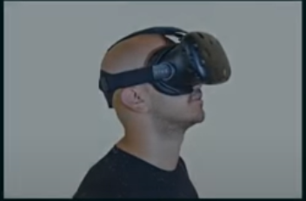
Concept of Virtual Machines
Definition: The fundamental idea behind a virtual machine is to abstract the hardware of a single computer (the CPU, memory, disk drives, network interface cards and so forth) into several different execution environments, thereby creating the illusion that each separate execution environment is running it’s own private computer.
A Virtual Machine(VM), is an environment, usually a program or operating system, which does not physically exist but is created with another environment.
Allows the ability to “run a computer within your computer”.

Slide 48
Concept of Virtual Machines
The first use of virtual in computing appears to have been in the M44/44X project at IBM Yorktown Research Center in the early 1960s. David Sayre and Les Belady were on the team led by Bob Nelson that developed a method of partitioning an IBM 7044 machine into sub- machines that were 7044 images with less memory.
A "virtual machine" was originally defined by Popek and Goldberg as "an efficient, isolated duplicate of a real computer machine."
Virtual machines are based on computer architectures and provide functionality of a physical computer. Their implementations may involve specialized hardware, software, or a combination.
In computing, an emulator is hardware or software that enables one computer system (called the host) to behave like another computer system (called the guest). An emulator typically enables the host system to run software or use peripheral devices designed for the guest system. Emulation refers to the ability of a computer program in an electronic device to emulate (or imitate) another program or device.
Virtual machines differ and are organized by their function:
System virtual machines (also termed full virtualization VMs) provide a substitute for a real machine.
Process virtual machines are designed to execute computer programs in a platform-independent environment.

Slide 49
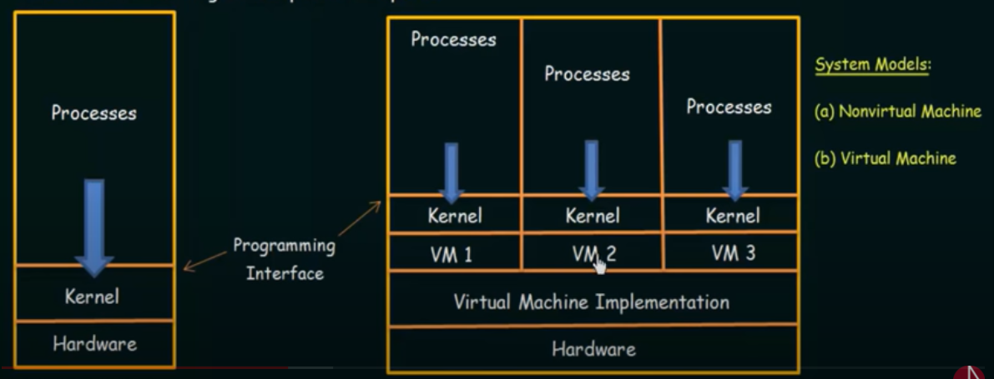
Concept of Virtual Machines
(a)
(b)

Slide 50
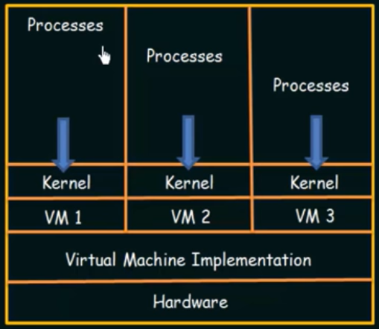
Implementation
Virtual Machine Software – Runs in Kernel Mode
Virtual Machine itself – Runs in User Mode
Just as the physical machine has two modes, however, so must the virtual machine.
Consequently, we must have:
A virtual user mode and
A virtual kernel mode
BOTH OF WHICH RUN IN PHYSICAL USER MODE
Virtual Machine has many benefits like protection of resources as we don’t have to share the resources with other processes. All the resources of one virtual machine is completely isolated with other virtual machines. Hard disk also shared among the machines (called mini disk).
By using VMWare or Virtual Box, we can install virtual machine in our system.

Slide 51
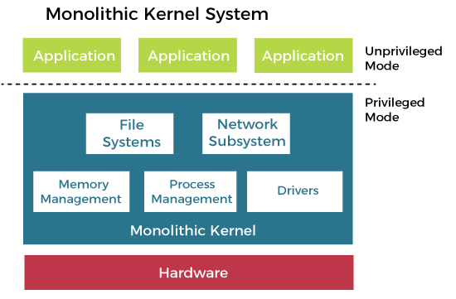
Monolothic Structure

